Slide 1
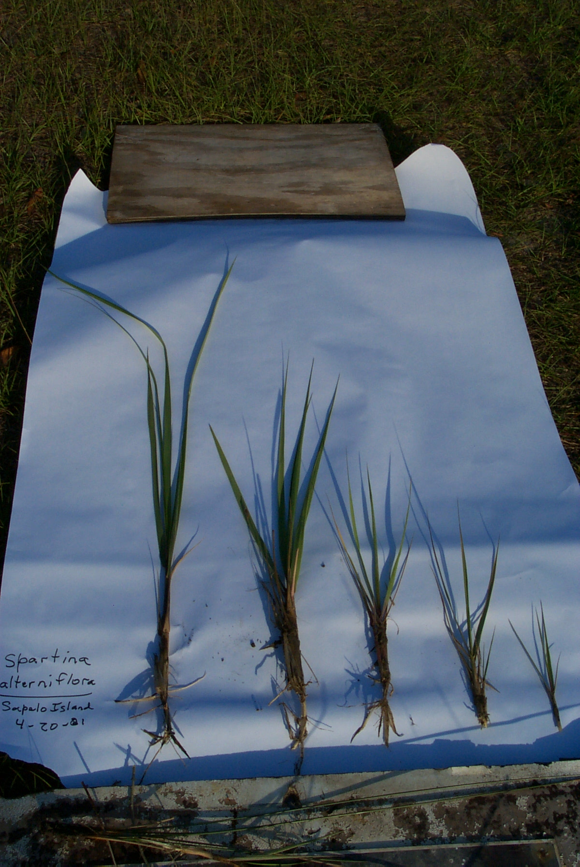
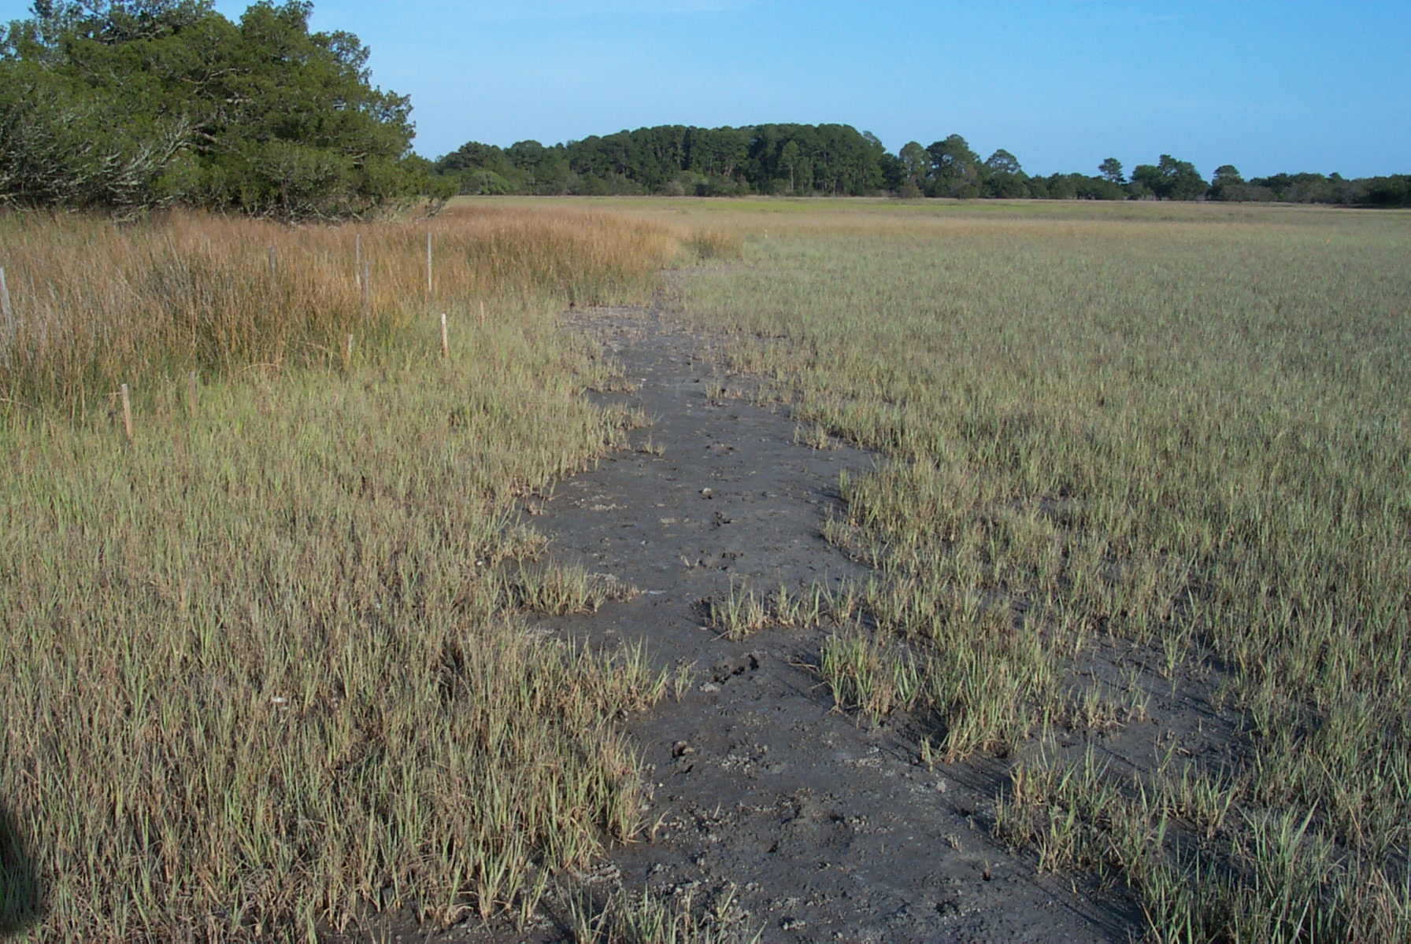
Remote Sensing
of Salt Marsh
Biomass at the
GCE
John Schalles
Christine Hladik
Steve Pennings
.
Spartina plants
At Sapelo Island
April 20, 2001

Slide 2
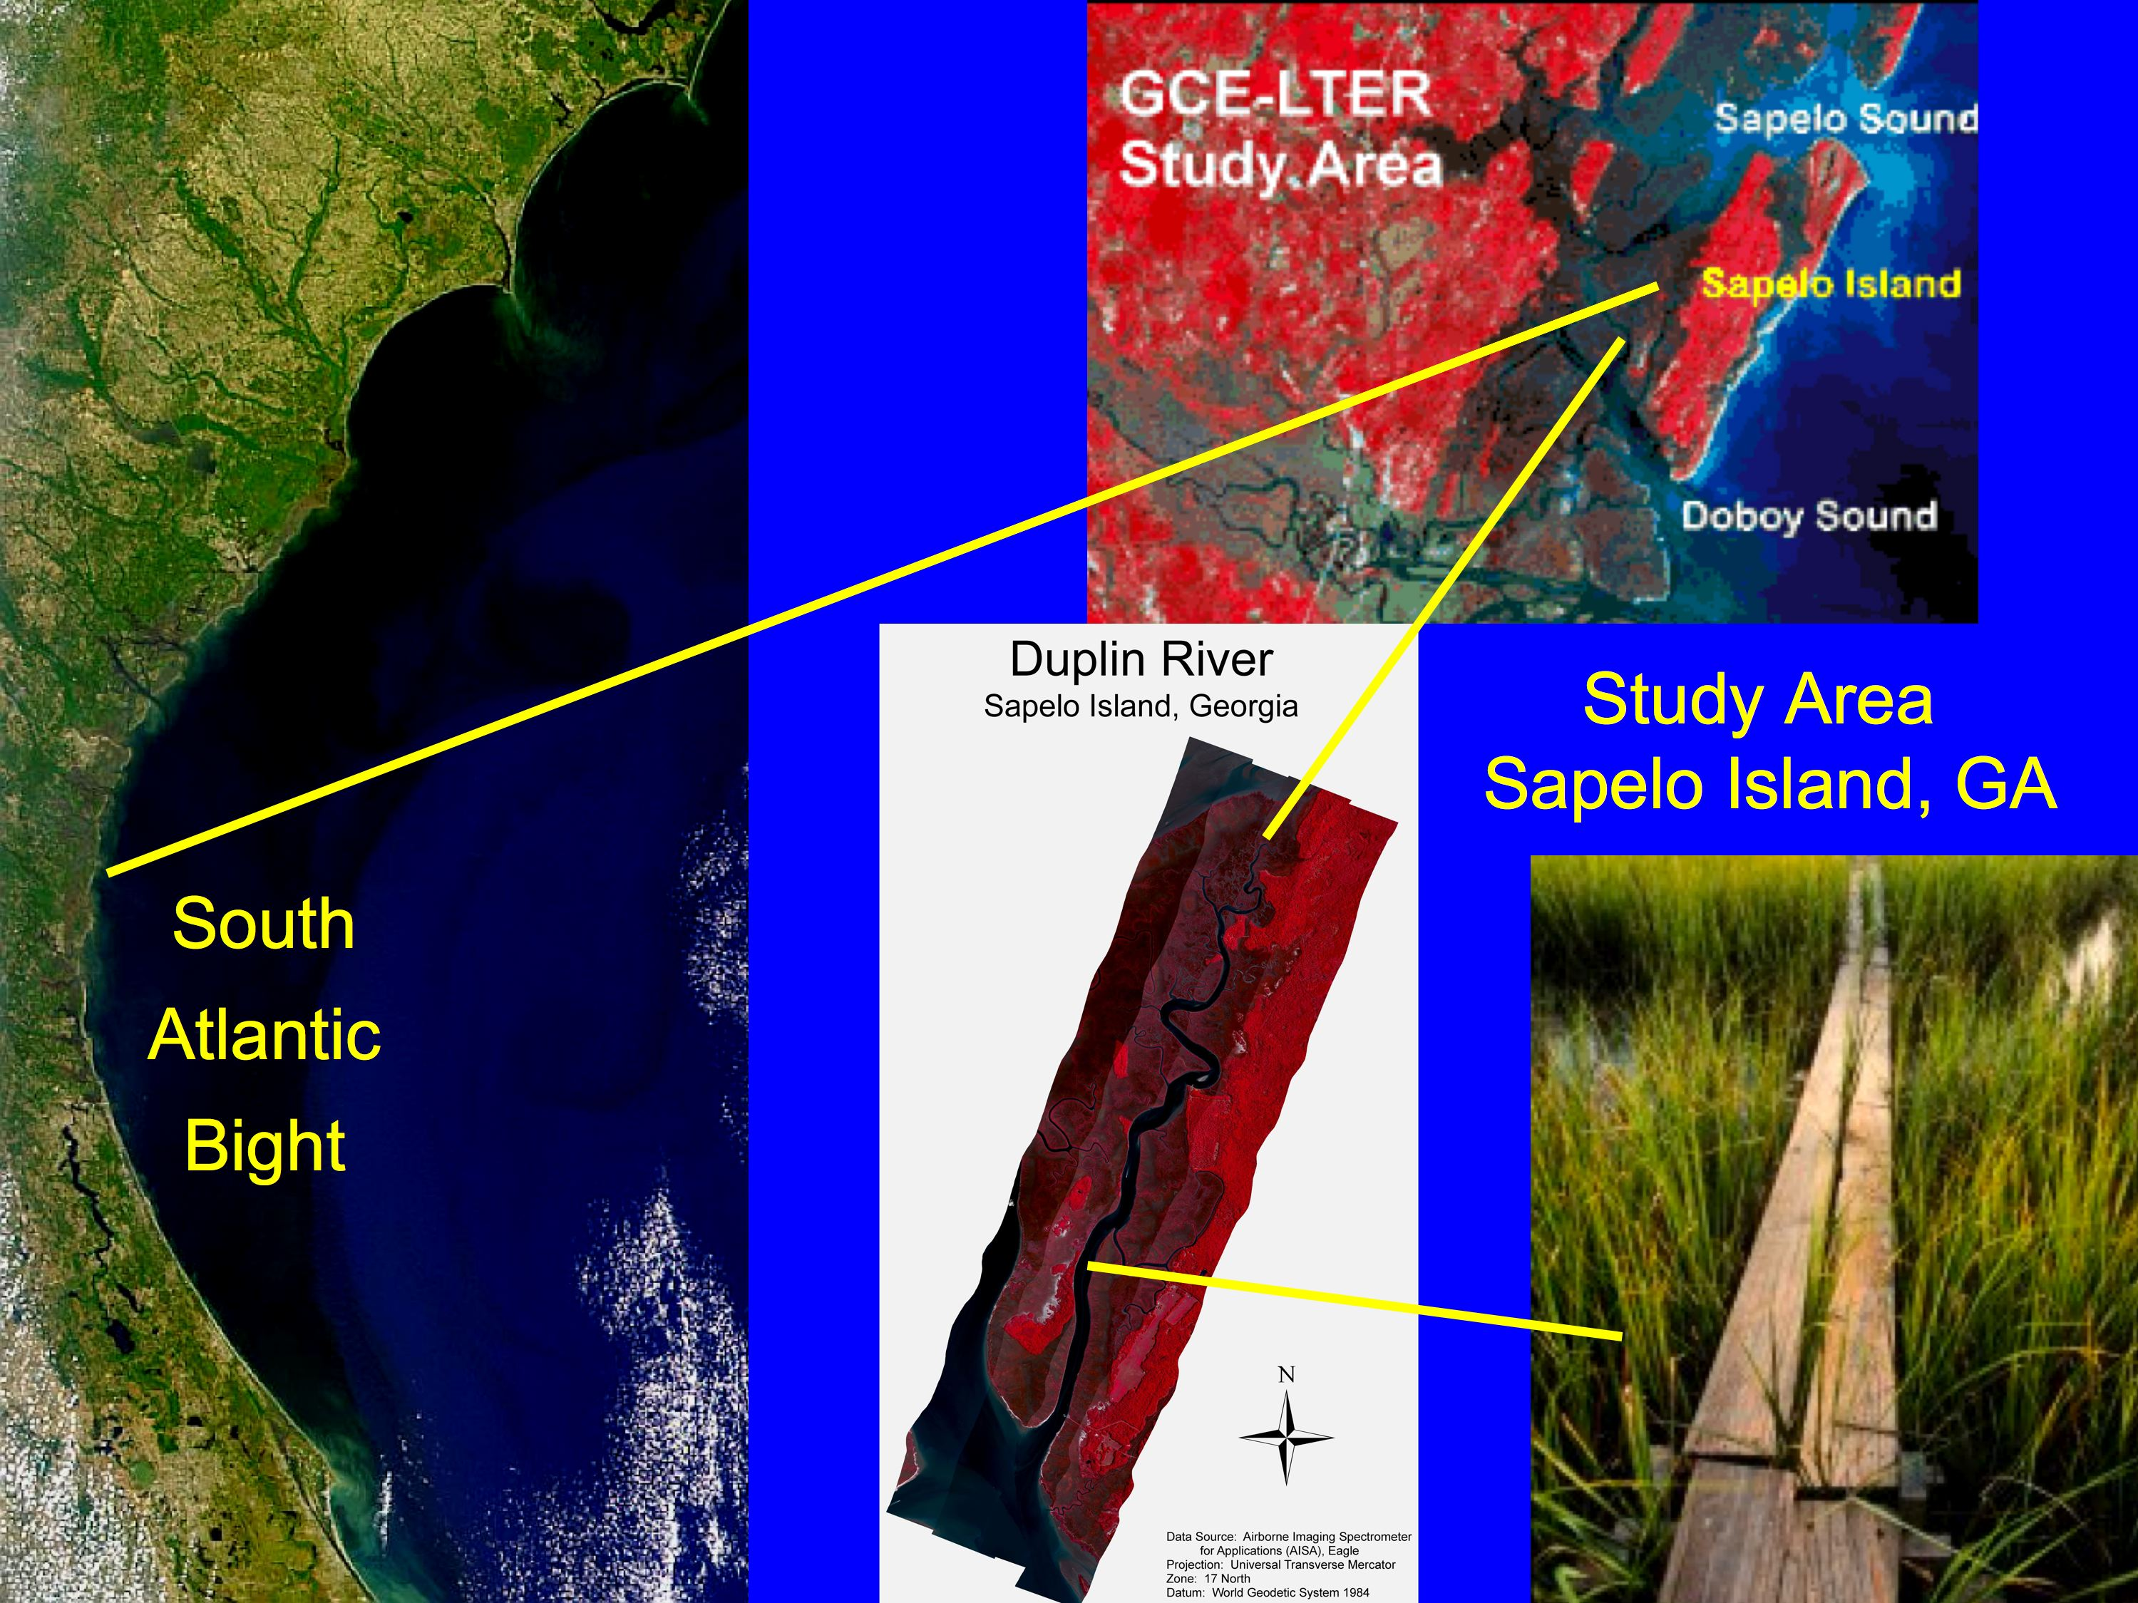

Slide 3
Hladik (2012) – Ph.D. Dissertation – Univ. of Georgia
manuscript in review – Hladik, Alber, Schalles

Slide 4
Regressions of Clip Plot Biomass against Vegetation Indices from 2006 AISA Imagery
r2 = 0.735
r2 = 0.527
• NDVI most robust index,
but saturates at higher
biomass
• VARI Green Index relatively
linear, but more scatter and
poor fit with Juncus stands
r2 = 0.642

Slide 5
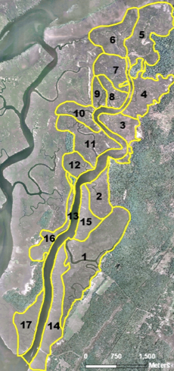
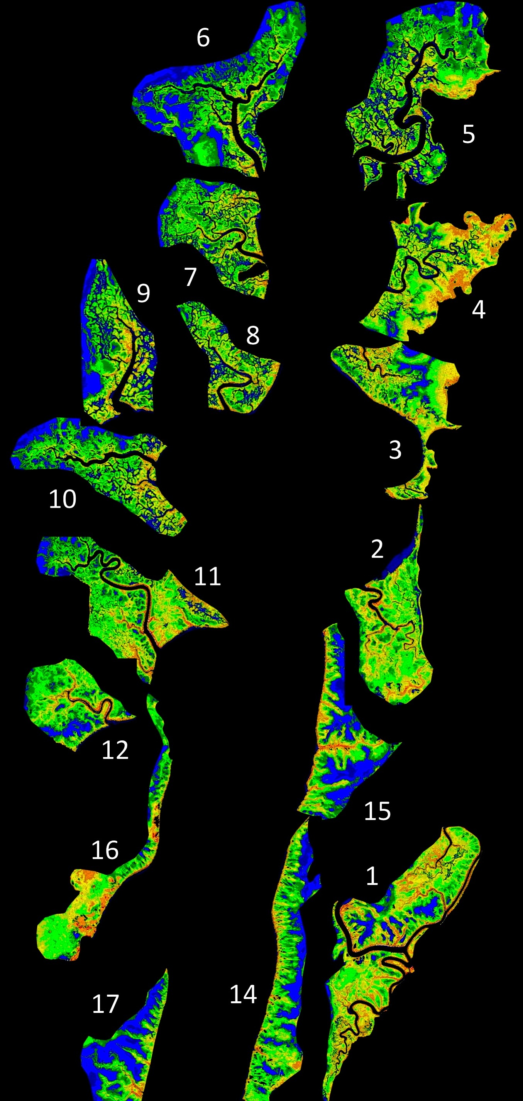
DUPLIN
TIDAL
WATERSHED
SUB-
WATERSHED
ANALYSIS

Slide 6
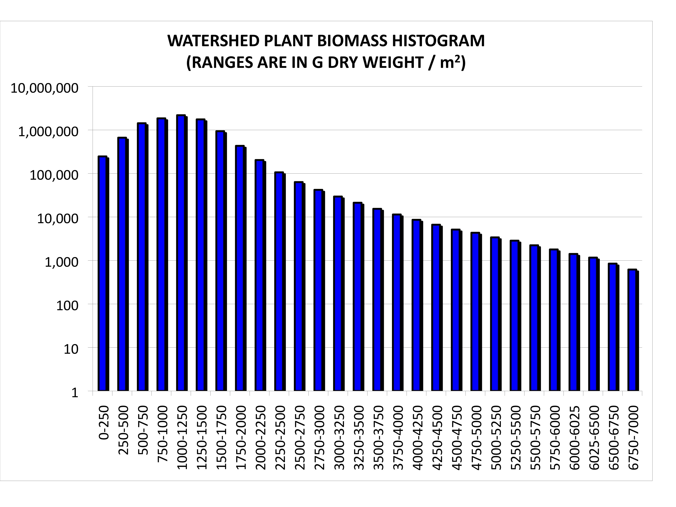
A
B
Histograms of vegetation above ground biomass (A) linear scale and (B) logarithmic scale

Slide 7
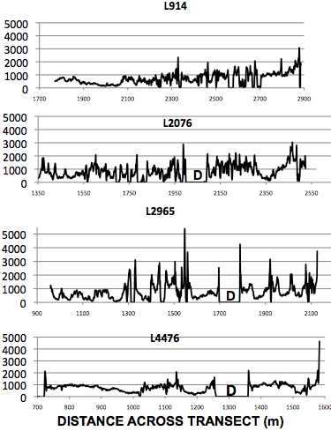
Above Ground Biomass
AGB
A
A
B
B
C
C
D
D
Duplin
River
Watershed

Slide 8
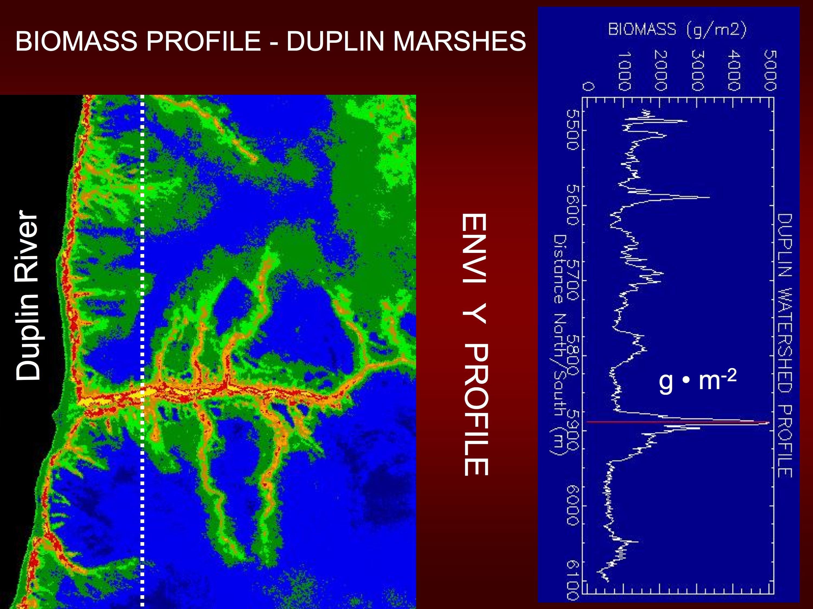

Slide 9
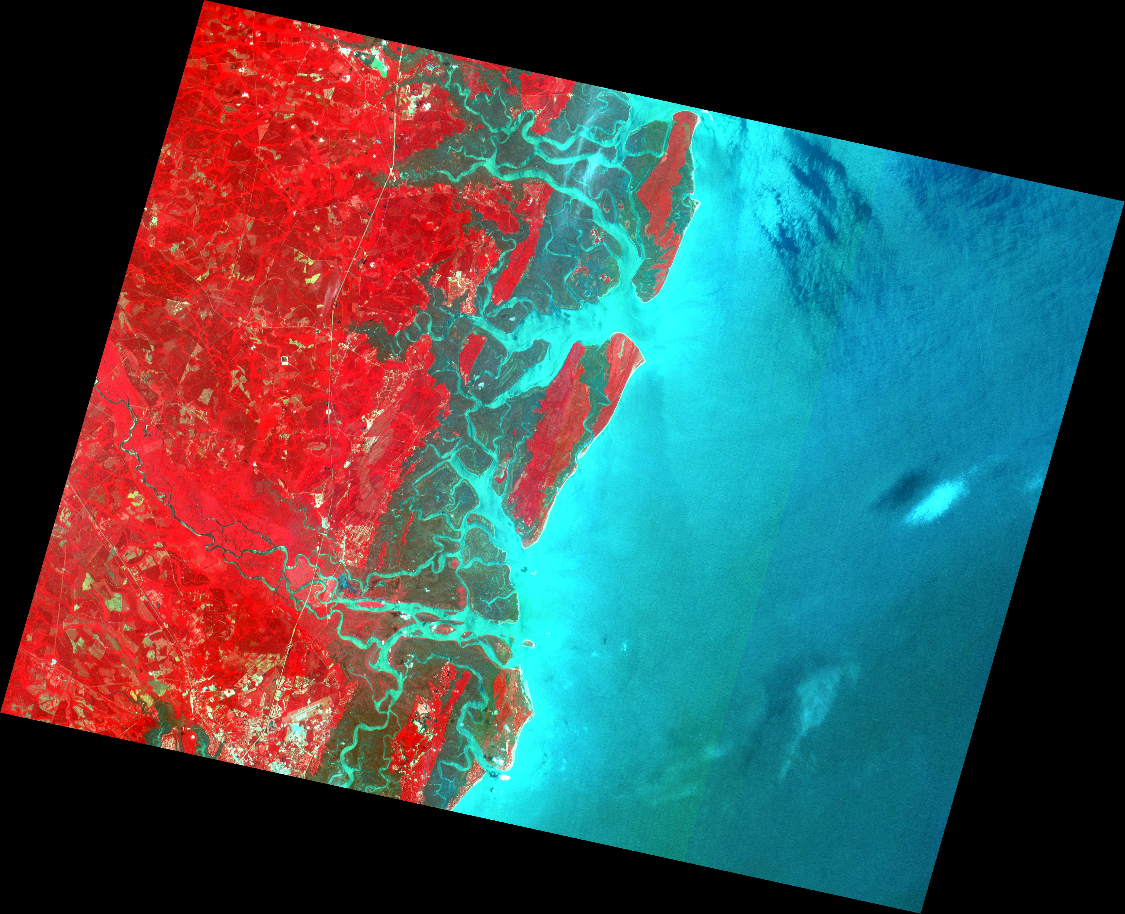
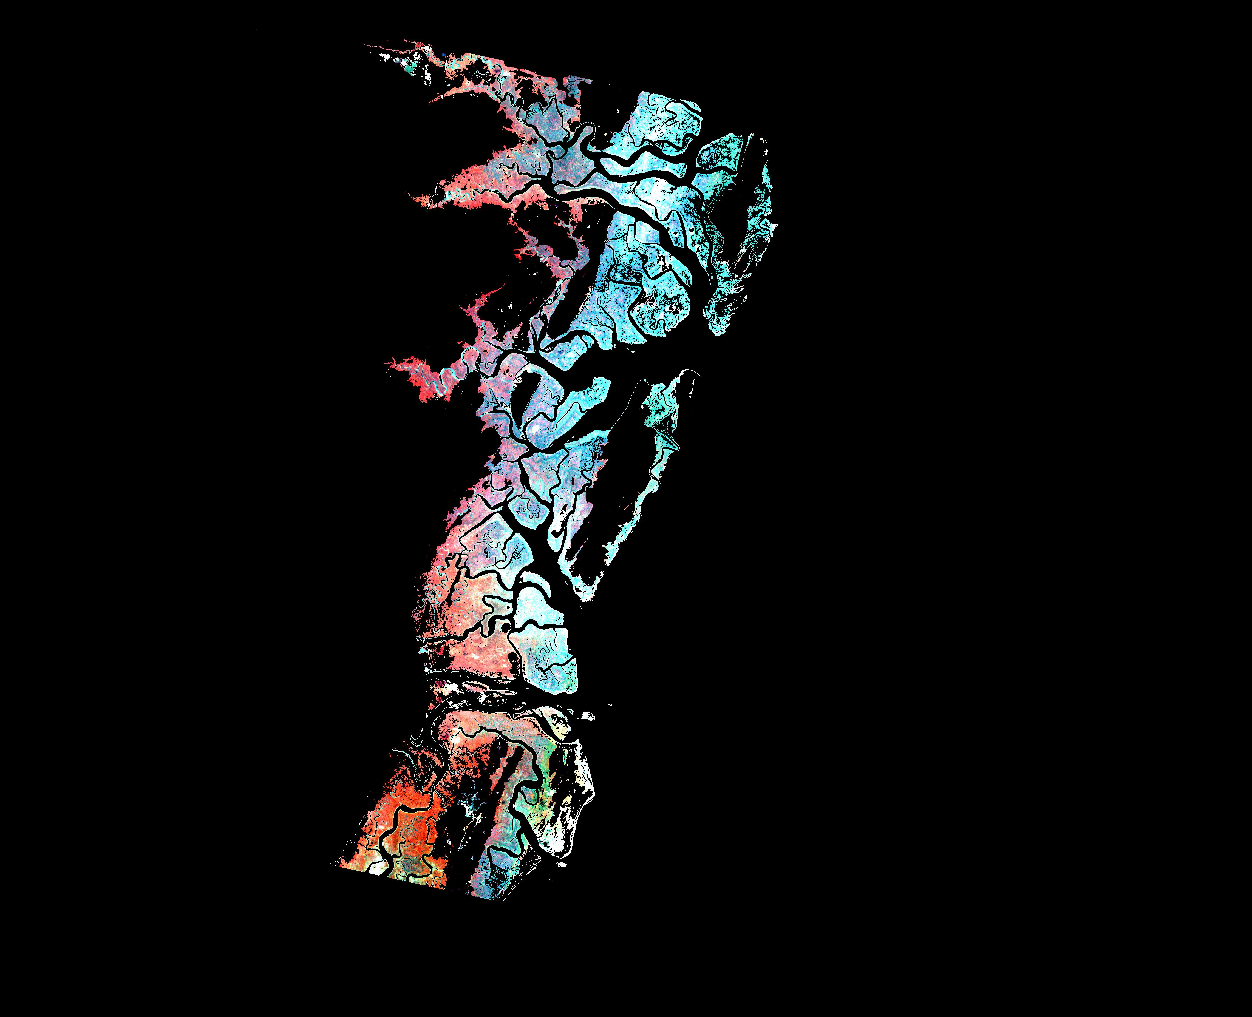
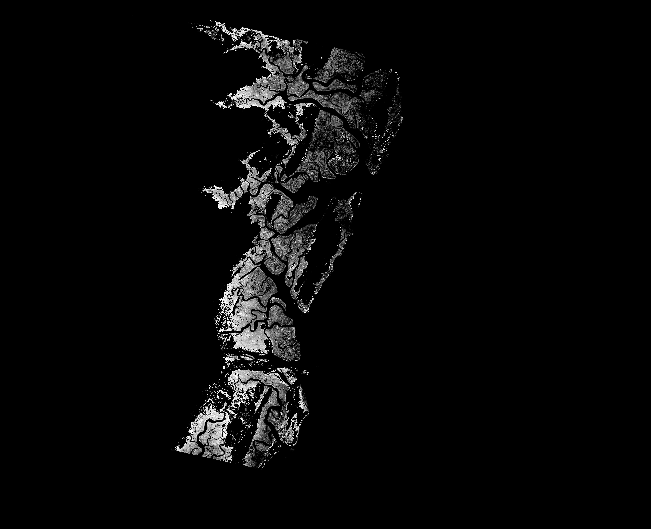
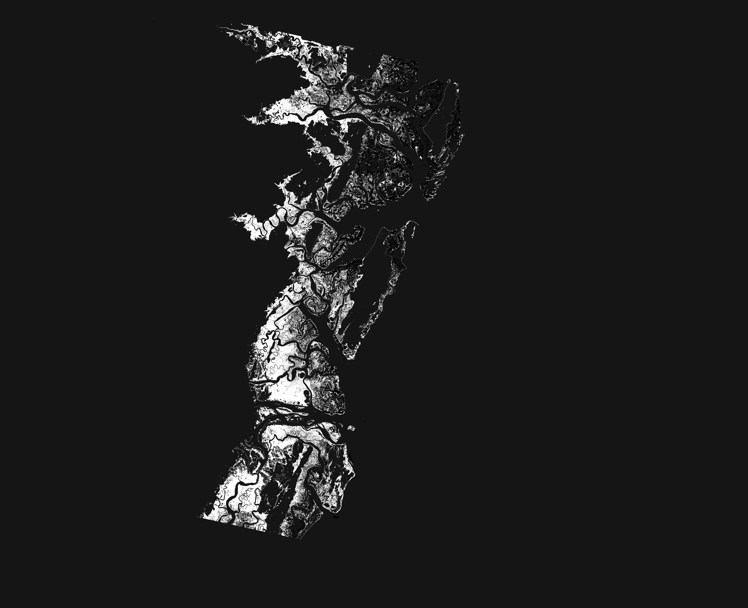
SPOT2
IMAGE
6-29-06
618 / 287
GEORGIA
MAINLAND
GEORGIA
BIGHT
SAPELO ISLAND
SALT MARSH
NDVI
COLORIZED
PRODUCT
ADAM RIFE
CREIGHTON
ATS 660
COURSE
PROJECT
SAPELO
SOUND
ST. SIMONS ISLAND
NDVI
MSAVI
DOBOY
SOUND
MSAVI
ALTMAHA
RIVER

Slide 10
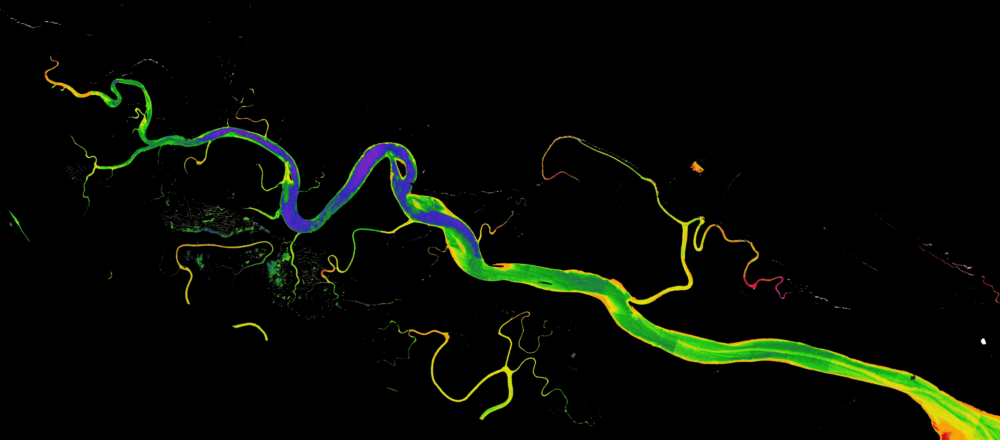
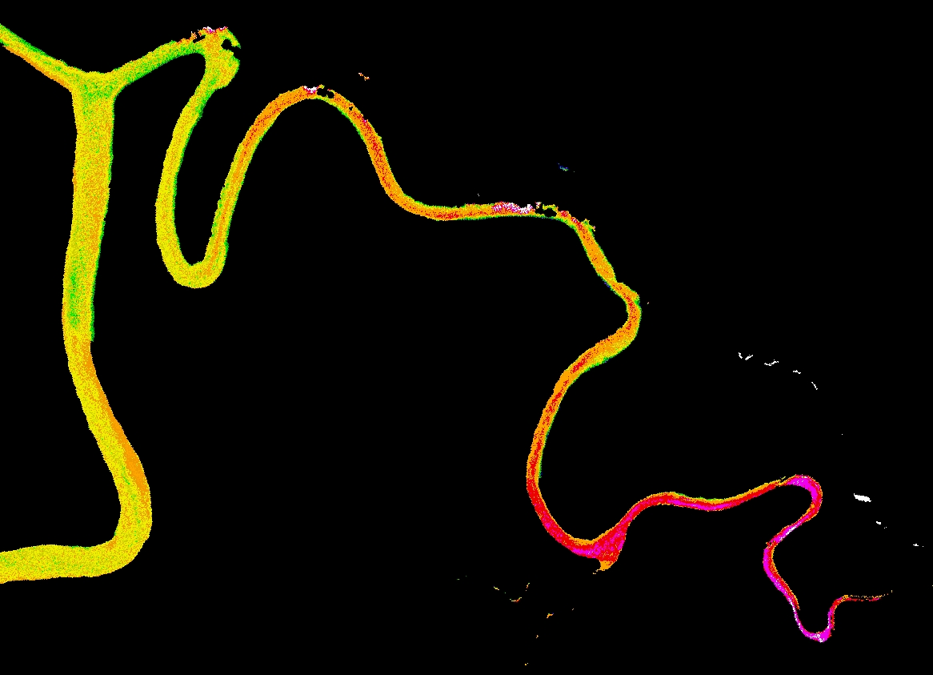
Upper Duplin
Forks
N
CALMIT AISA Image
June 10, 2006
Schalles & Hladik
(In Press)
Lumber
Landing
1
See Schalles & O’Donnell
Poster # 271
Marsh
Landing
A
B
1
Phytoplankton CHL a μg/L
SAPELO
ISLAND
NERR
DUPLIN
RIVER
AND
TRIBUTARY
STREAMS
C
Post Office Creek
Barn Creek
Figure 12.

Slide 11
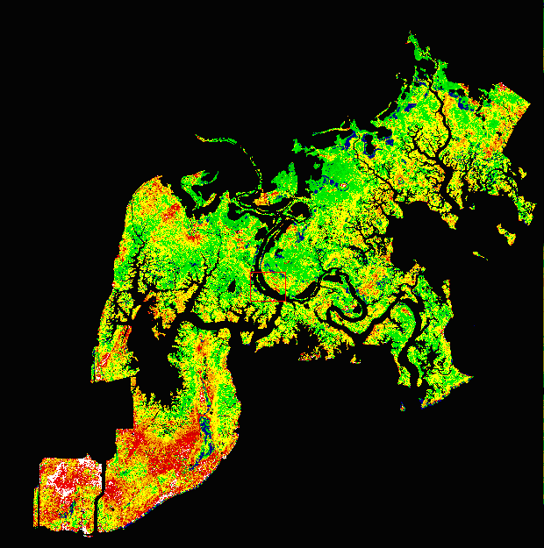
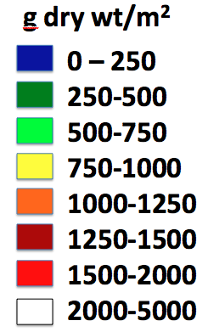
CALMIT-ECSC AISA IMAGERY
MAY, 2010
GRAND BAY NATIONAL ESTUARINE
RESEARCH RESERVE - SE MISSISSIPPI
SALT MARSH VEGETATION
PROVISIONAL BIOMASS MAP

Slide 12
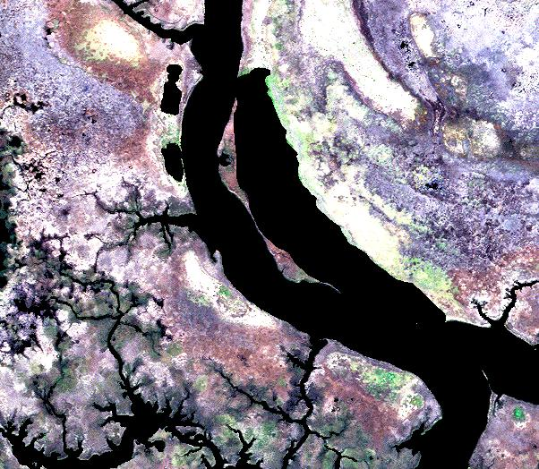
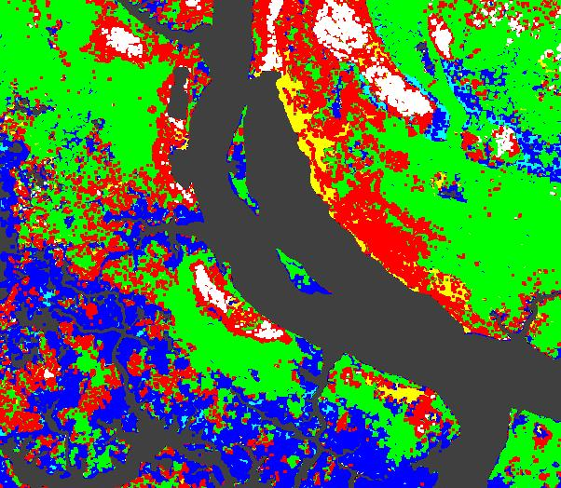
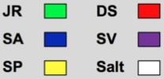
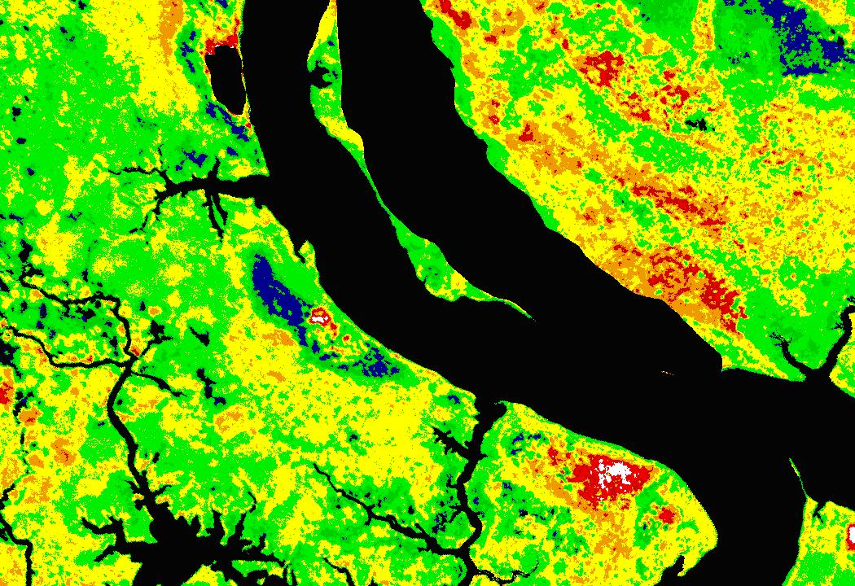
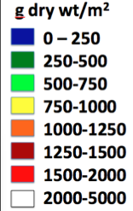
A
C
GRAND BAY NERR SALTMARSH
COMPARISONS OF
A. TRUE COLOR IMAGE
B. VEGETATION BIOMASS
C. VEGETATION CLASSIFICATION
B

Slide 13
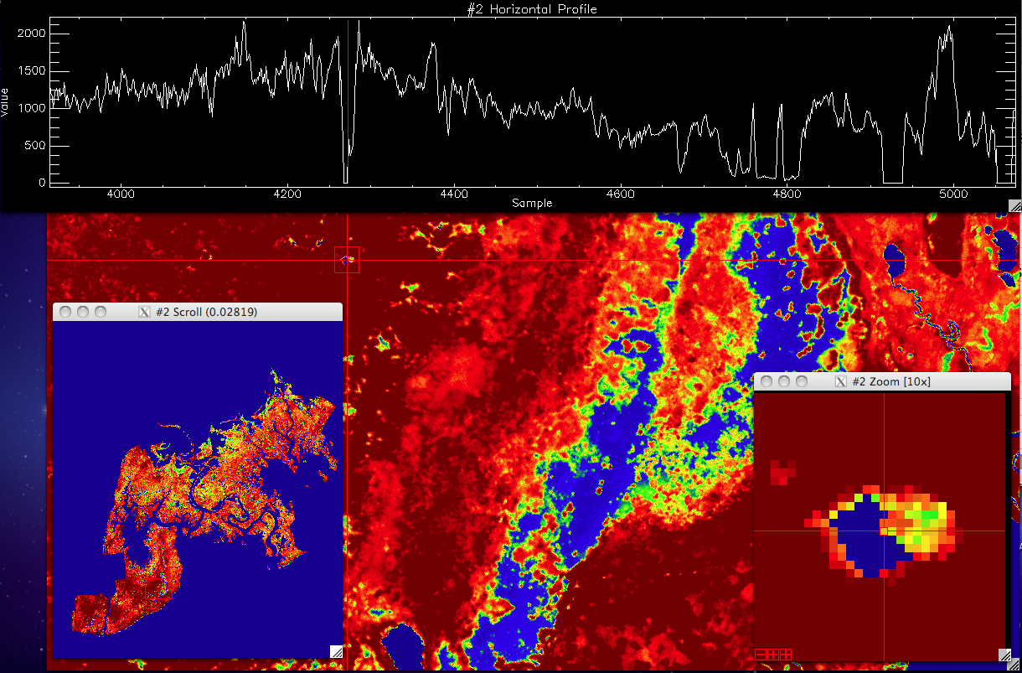
Salt
Pan
Grand Bay NERR
Marsh Biomass
Provisional Biomass Map of Grand Bay NERR Salt Marshes: AISA Eagle Imagery – May, 2010
Aboveground biomass values in graph are g dry wt / m2, using Duplin Watershed acalibration

Slide 14
SITES OF NOAA-ECSC AISA HYPERSPECTRAL FLYOVERS (2002-2010)

Slide 15
TEX ‘08
GB ‘03
ACE ‘03
CB ‘05
GB ‘10
AP ‘02
DEL ‘04
Normalized NDVI distributions a) TEX, b) GB ’03, c) GB ’10, d) AP ’02, e), AP ’06, f) SAP, g) ACE, h) CB and i) DEL.
(Seminara&Schalles, In Prep)
AP ‘06
SAP ‘06

Slide 16
Georgia Coastal Ecosystem LTER – Next Steps with Biomass
Temporal analysis with archival LANDSAT imagery, with atmospheric correction, masking, and vegetation indices
Attempt to calibrate LandSat derived marsh VIs to biomass using rescaled AISA 1 m map and archival field clip plot data
Examine relationships between upcoming carbon flux tower data and MODIS derived VIs
Perform measurements of belowground root biomass versus aboveground for different vegetation taxa groups
Use biomass distribution data to parameterize NPP models of Georgia salt marsh communities for spatially explicit predictions

