Slide 1



GIS Data and Tools for the LTER:
resources for site research and synthesis
September 10, 2012
Presenters: Adam Skibbe, Theresa Valentine, Aaron Stephenson
Jamie Hollingsworth, Jonathan Walsh

Slide 2
Hello and Welcome
Introductions –
  Who are we… the LTER IMC GIS WG (subset)
  Who are you?
    What is your position in the LTER?
    What is your working knowledge of GIS?
    What are your needs as (potential) users of data?
  An information exchange
  Presentation and discussion

Slide 3
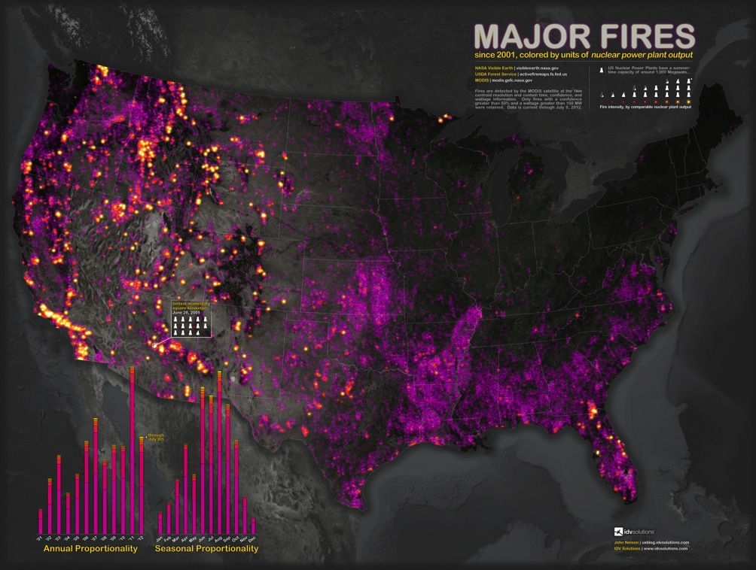
ASM Workshops!
GIS Data and Tools for the LTER: resources for site research and synthesis
Spatial Analysis Committee:
Using Remote Sensing to Estimate Biomass
GIS Ad-Hoc WG Meeting
* Not LTER/Workshop… just neat

Slide 4
GIS Working Group
  IMC WG related to Geospatial data and technologies.
  Our current foci have been on better management standards for geospatial data as it relates to the NIS, and dissemination of those data through online media.
      FGDC2EML
      LTER MapS update
      GeoNIS introduction
      Coordinate with new Geospatial Analysis Working Group

Slide 5
Geospatial Analysis Committee
Charged by Executive Board
Members include PI’s
Broader look: Acquisition of large data sets, analysis tools.
Jamie Hollingsworth and Theresa Valentine represent the GIS Working Group (and IM) on this committee
First Effort:
  Working with SDSC center (Opentopography.org) on storage/access to LiDAR data for LTER sites.

Slide 6
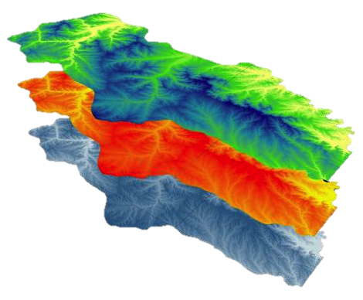
Overview
Let’s talk about GIS
  Seriously, let’s converse… ask questions
GIS at LTER Sites
GIS at LTER Network
GIS Tool Options
  Open source alternatives
  Online mapping
  Mobile options
  Other options
Resources of the personnel kind

Slide 7
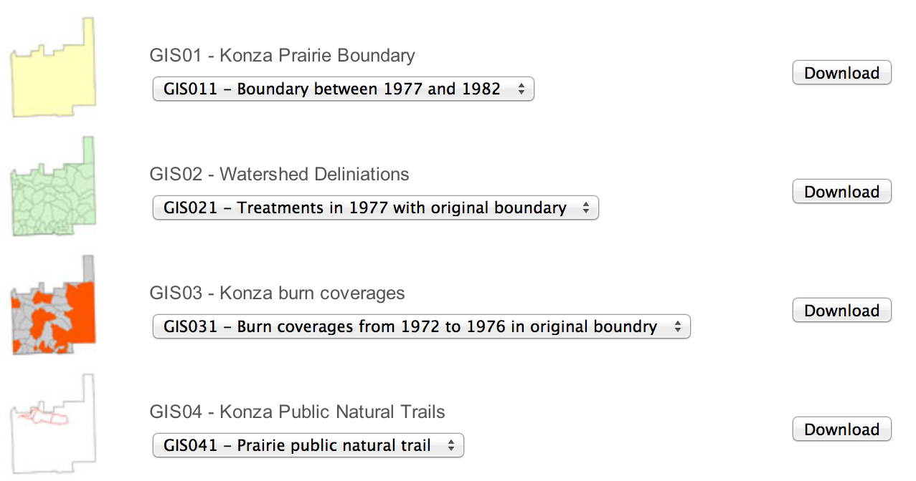
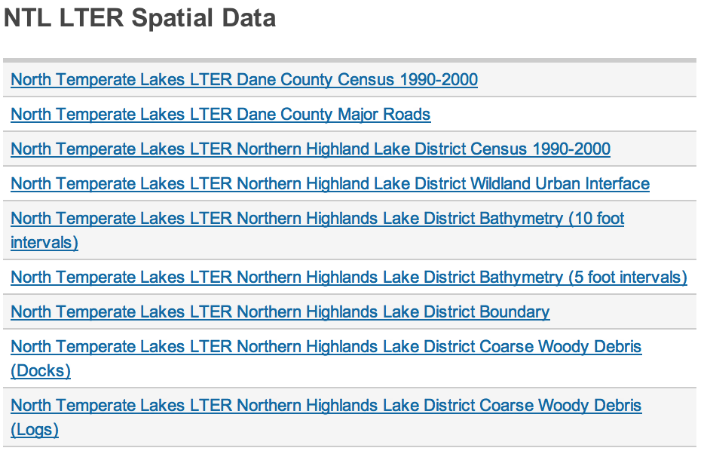
Data!
Some obvious points* on data
  Site based data is site based
  Most sites have something
  If spatial data is spatial… why isn’t it’s access?
  Download and go
Non-LTER options available
  DEMO later
What are your needs?
Talk to your IM to support
*pun intended

Slide 8
Network Data
Some non-LTER cross site options
LTERMapS and GeoNIS
Search of data at LNO: only 23 data sets (sites working on getting data into EML)
All sites using GIS except for CCE, PAL, and SBC (as of 2010 survey), although these sites use other spatial data application.
17 sites using GIS server technology. (web mapping)

Slide 9
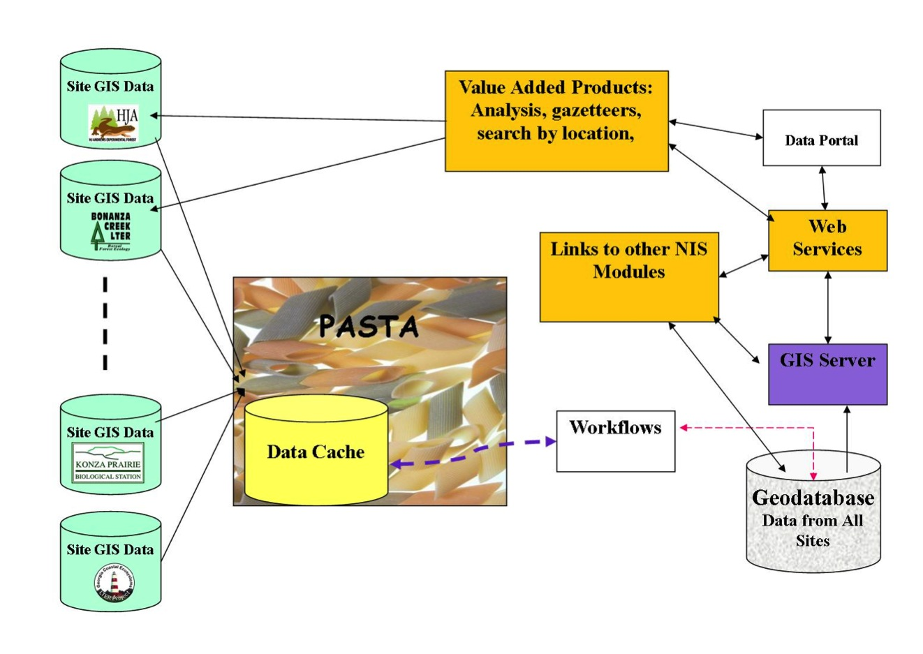
GeoNIS

Slide 10
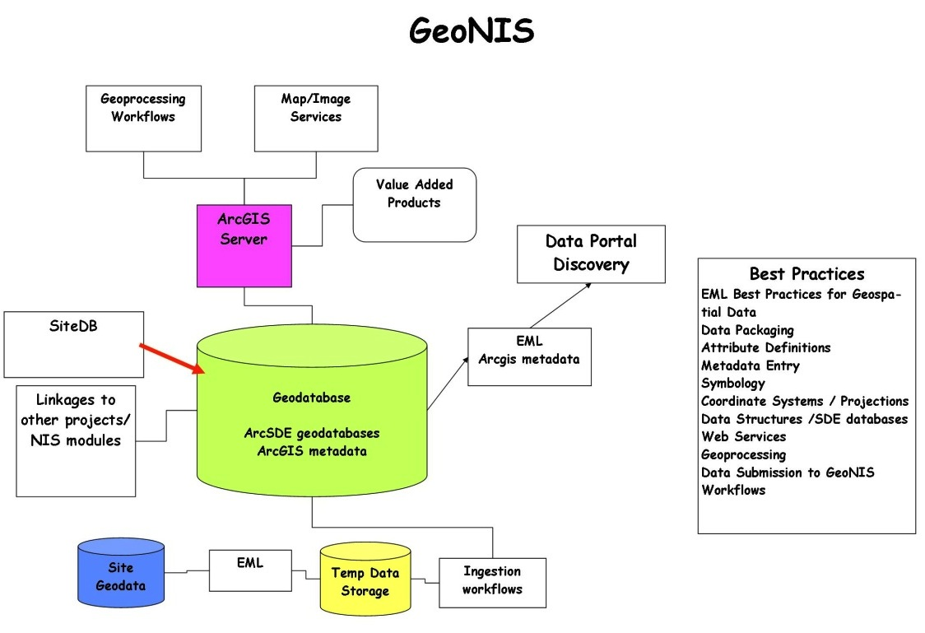
GeoNIS

Slide 11
LTERMapS
LTER Map Services
Exploration of various options
  ESRI based
  Google based
Provide interactive web mapping tools and suggestions for:
  Network level (more general audience)
  Site level (more specific content, analyses?)
Access existing data
  Local spatial and non spatial datasets
  EcoTrends
  SiteDB

Slide 12
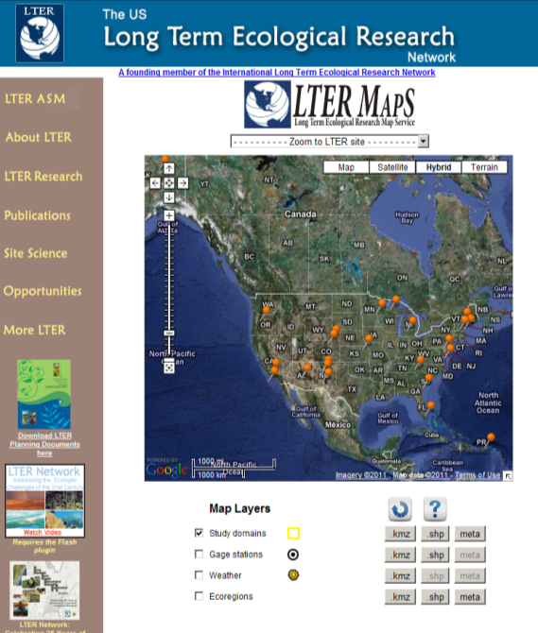
LTERMapS
Phase 2… in development, image coming soon

Slide 13
GIS Tools
Data management of geospatial data is inclusive of both GIS and remote sensing products though specific disciplines are different in scope, focus, and standards.
Desktop GIS
  Vector and raster (image) datasets
  More robust: advanced cartography, analysis, geostatistics, etc.
  ESRI – ArcGIS 10.0 sp2
  Integration with relational databases (Oracle/SQL Server)
Remote Sensing
  Focus on raster (image) analysis and classification (See GAP, NDVI, Etc.)
  LiDAR emerging technology
  ERDAS, ENVI, IDRISI, GRASS software products

Slide 14
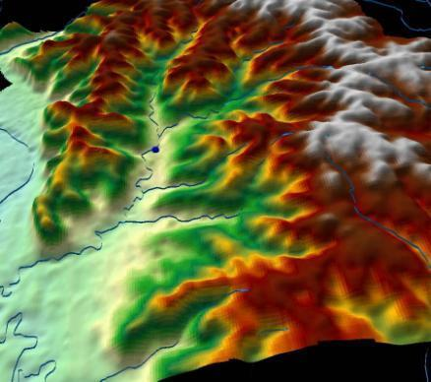
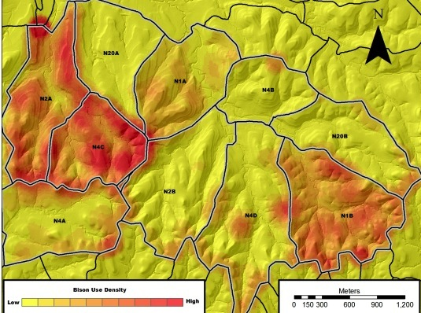
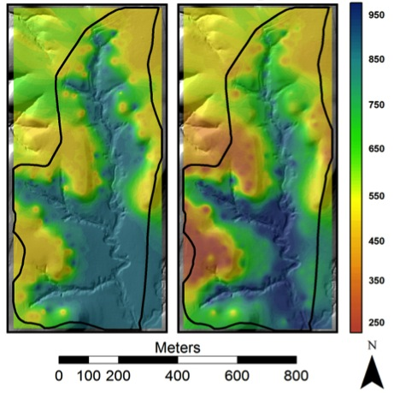
Tools
LTER sites mostly use ArcGIS products
Visualization options… the power of pictures
Plenty of Open Source options

Slide 15
Open Source Tools
Open Source GIS
  Nearly all of the most popular/trusted projects are sponsored by the Open Source Geospatial Foundation (http://www.osgeo.org)
  Nearly all OSGeo products can interact with ESRI data formats and services
    Desktop
      Quantum GIS, gvSIG, GRASS GIS, uDIG, …
    Server
      MapServer, GeoServer, MapGuide, OpenLayers …
    Database
      PostGIS for PostgreSQL is the favorite, and standards-based, while MySQL Spatial is immature and not standards-based
    Libraries
      GDAL, OGR, FDO, GEOS, …

Slide 16
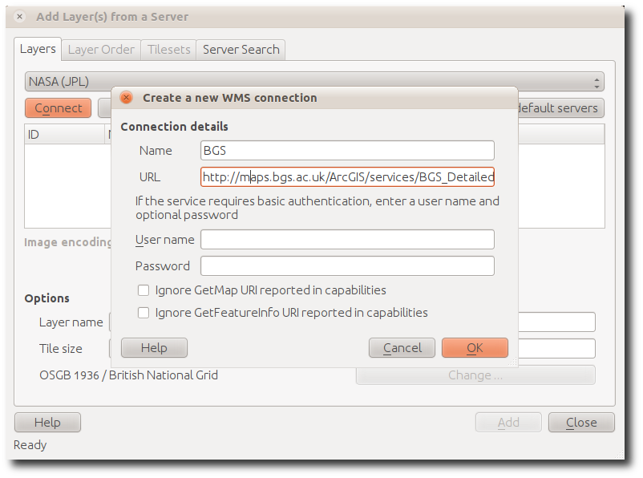
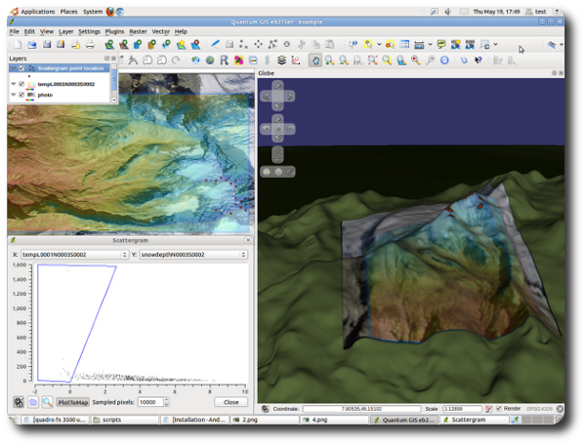

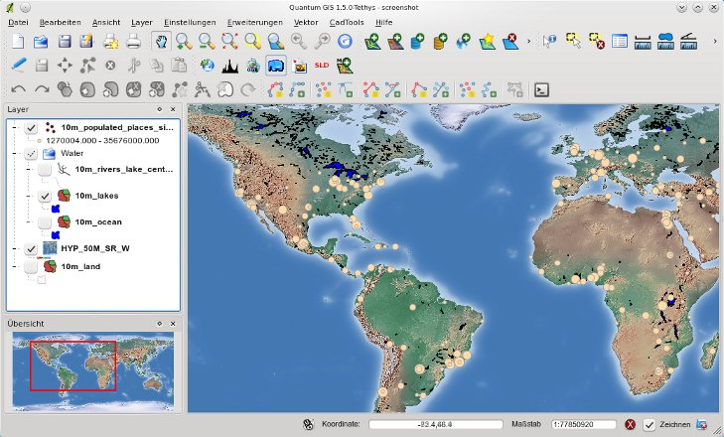
Open Source… demo?

Slide 17
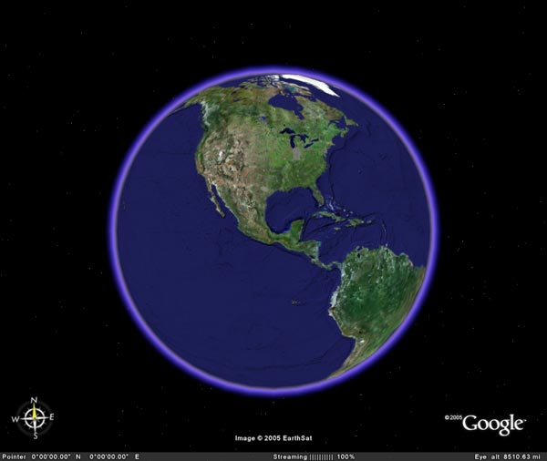
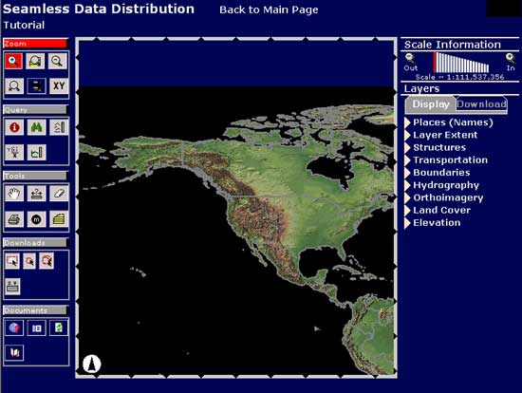

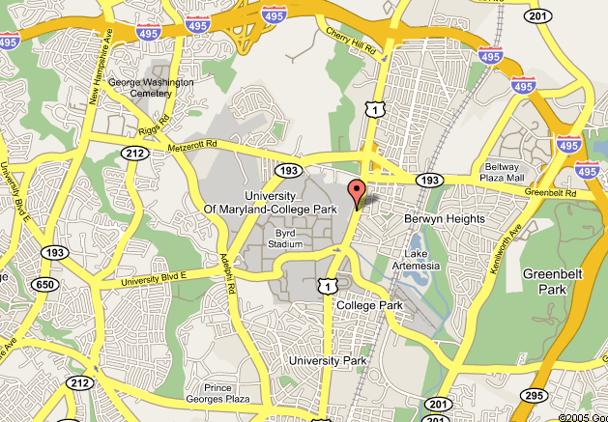

On-line Tools
  Online mapping providers
    Google Maps, Earth
    Bing!
    Yahoo
    Mapquest
  Customized applications
    ArcGIS Server 10
    ArcGIS Online
    API’s
  Data services
    WMS,WFS,WCS,etc
    USGS, USDA, ESRI, Etc.

Slide 18
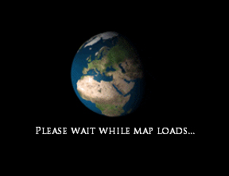

Slide 19




Mobile Solutions… demo

Slide 20
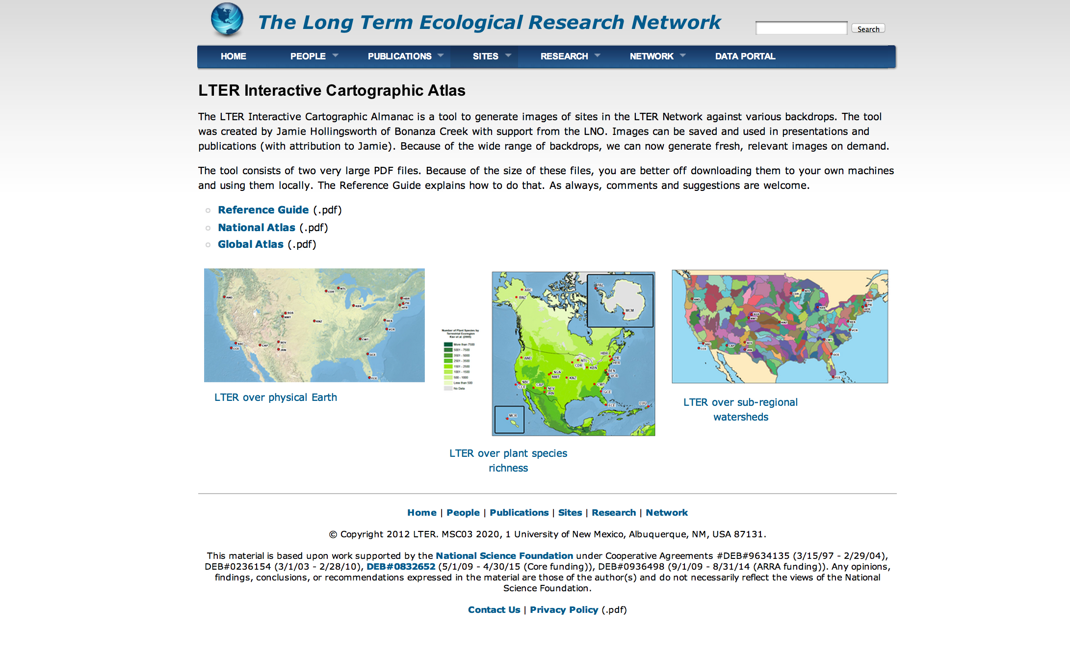
Cartographic Atlas… demo?

Slide 21
WG Resources
Open LTER IM GIS mailing list:
GIS@lternet.edu
Adam Skibbe, Chair IMC GIS WG:
askibbe@ksu.edu
Theresa Valentine, Co-Chair Geospatial
theresa.valentine@oregonstate.edu
Databits:
http://databits.lternet.edu/
IM web portal pages:
http://IM.LTERNET.EDU/PROJECTS/GIS_DATA/
We put the science in GIS

Slide 22
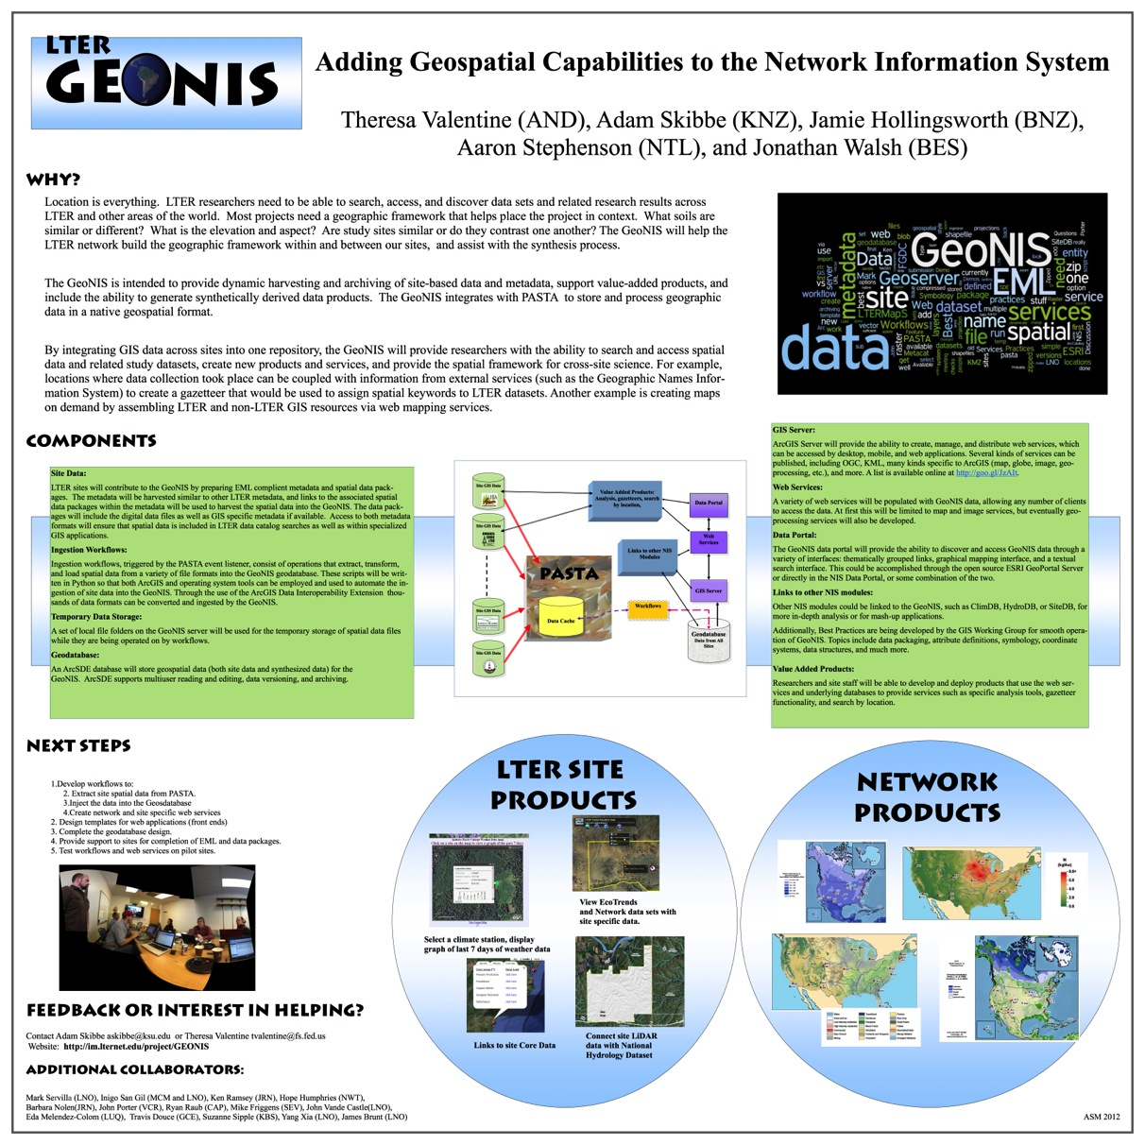

Questions? … Let’s Chat.

