Slide 1





Using LiDAR to map and model variation in
old-growth forest carbon density
Thomas A. Spies
Rupert Seidl
Werner Rammer
E. Ashley Steel
Robert J. Pabst
Keith Olsen

Slide 2
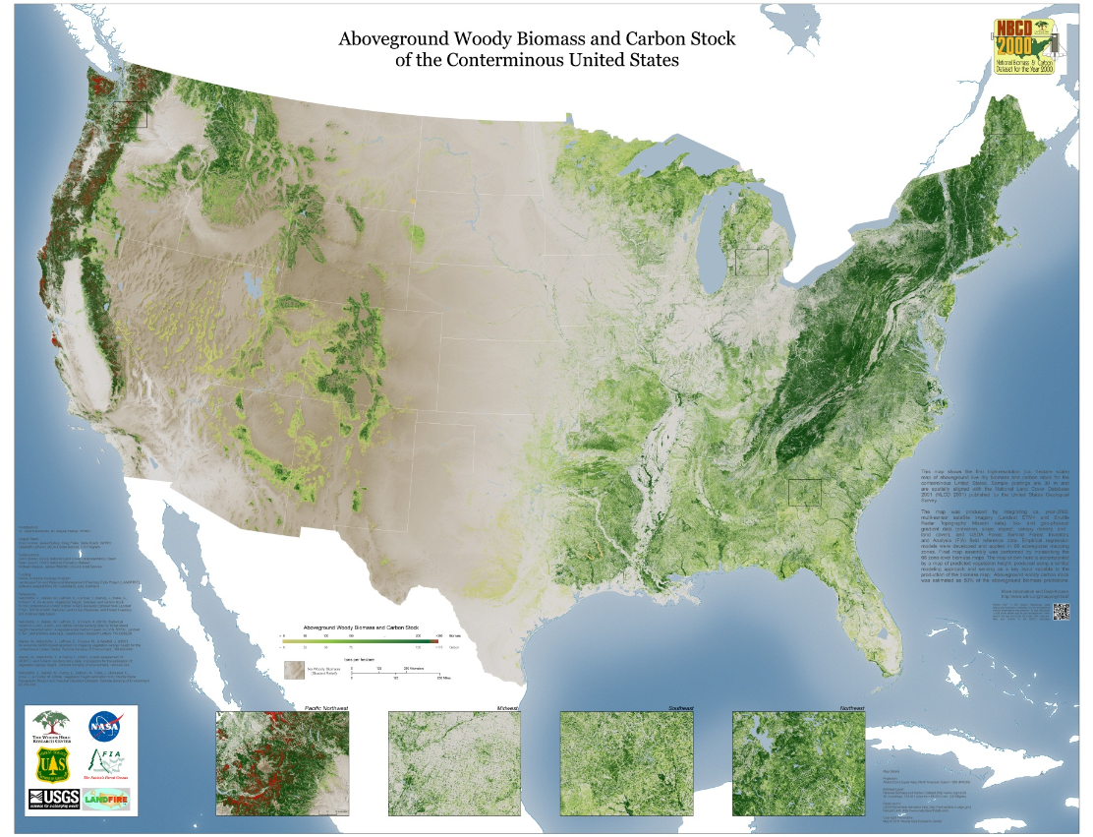
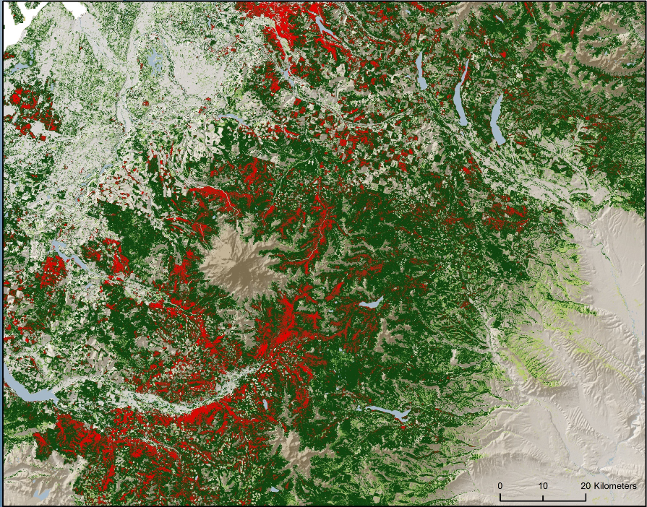
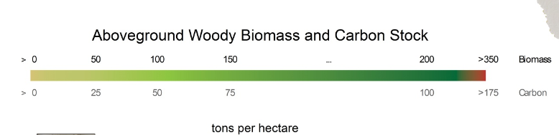

Slide 3
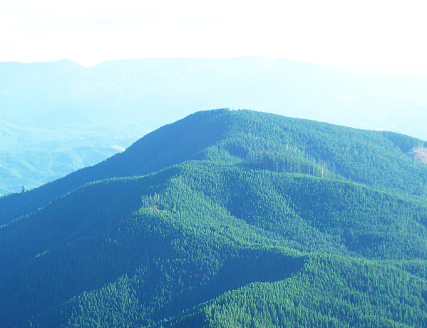
Question
How variable are forest C stocks at the landscape scale?
What drives spatial variability in C density?
Environment
variation in climate and soil
likely going to change drastically in the future
Community structure
stand dynamics
can be influenced by management
Notes:
how external drivers and internal processes of community structure influence ecosystem functioning

Slide 4
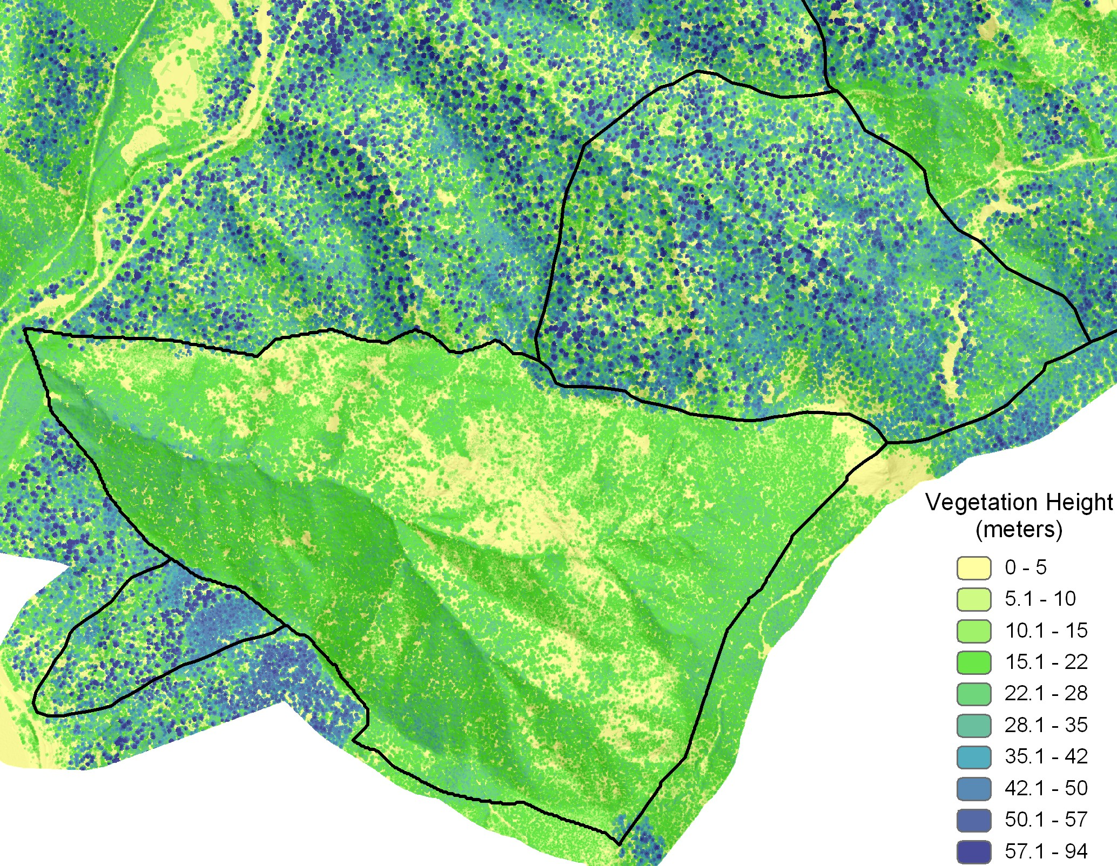

Slide 5
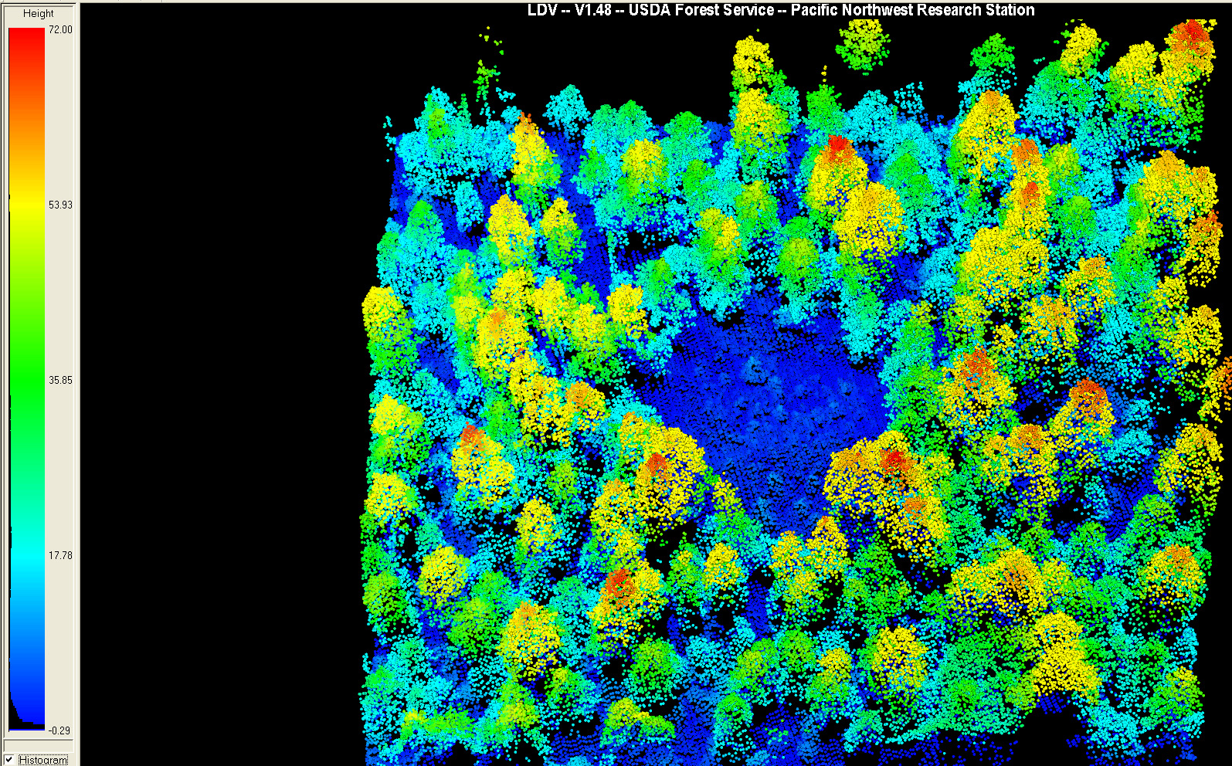
HJA Large Gap – Height Point Cloud

Slide 6
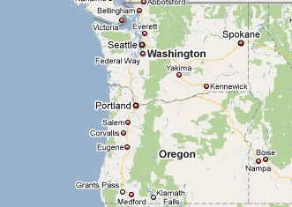
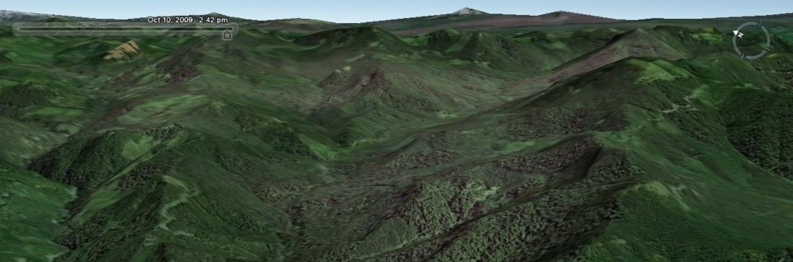
The study system
Western central Cascades in Oregon
hotspot of terrestrial C storage – among the most C-rich ecosystems globally
°C
HJ Andrews Experimental Forest
6364 ha, whereof 2191 ha old-growth
elevation range: 410 – 1,630m
Tsuga heterophylla to Abies amabilis zone
temperature: 1°C (I) to 18°C (VII)
precipitation: 2300mm (base) to 3500mm (high elevation)

Slide 7
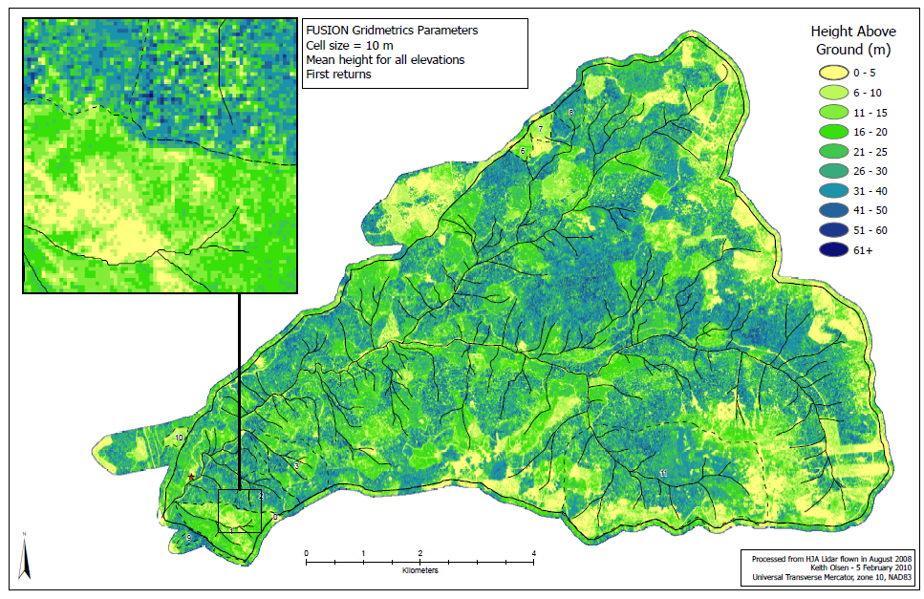
Estimating aboveground C density
LIDAR-based model of aboveground live carbon density
based on 708 terrestrial inventory plots
spatial resolution 5m cells, aggregated to 100m cells
permutation model approach, R²=0.768
final predictors: 95th percentile return height, elevation, spatial variation in Lidar return height
Map of LiDAR first returns

Slide 8
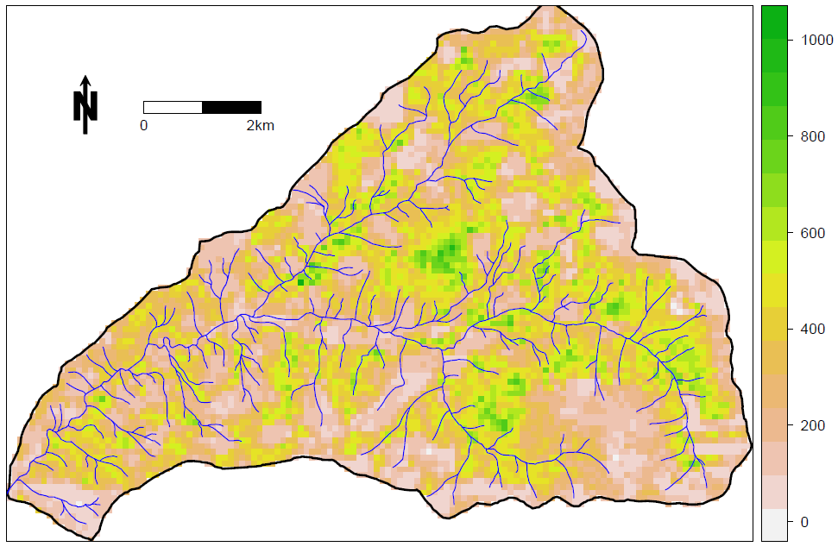
Aboveground C density at the HJ Andrews
Mg C ha⁻¹
Mean: 316.8 Mg C ha⁻¹
SD: ±168.3 Mg C ha⁻¹
95th percentile: 599.9 Mg C ha⁻¹

Slide 9
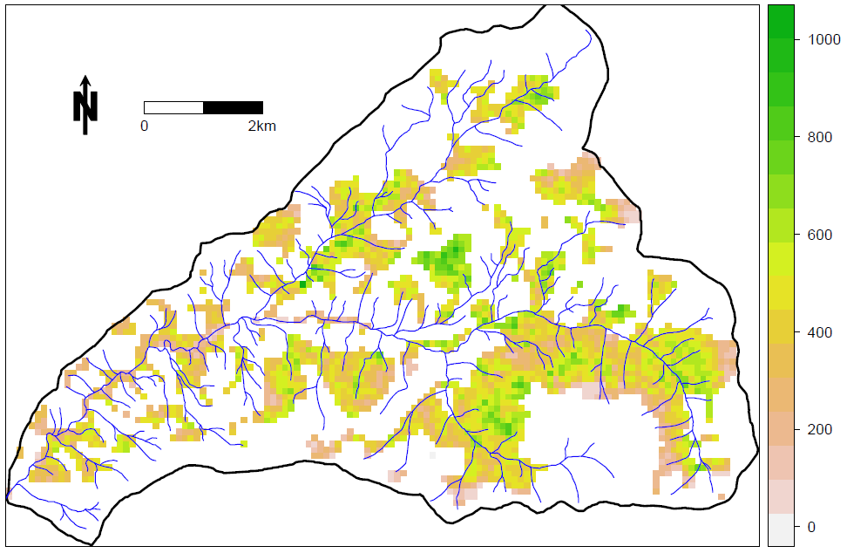
Aboveground C density in old-growth forests
Mg C ha⁻¹
Mean: 435.1 Mg C ha⁻¹
SD: ±149.2 Mg C ha⁻¹
95th percentile: 667.3 Mg C ha⁻¹

Slide 10
Simulation modeling as diagnostic tool
iLand: the individual-based forest landscape and disturbance model
simulates stand dynamics (e.g., competition) at individual-tree resolution across large areas
process-based simulation of the forest C cycle
Seidl et al. (2012)
http://iLand.boku.ac.at

Slide 11

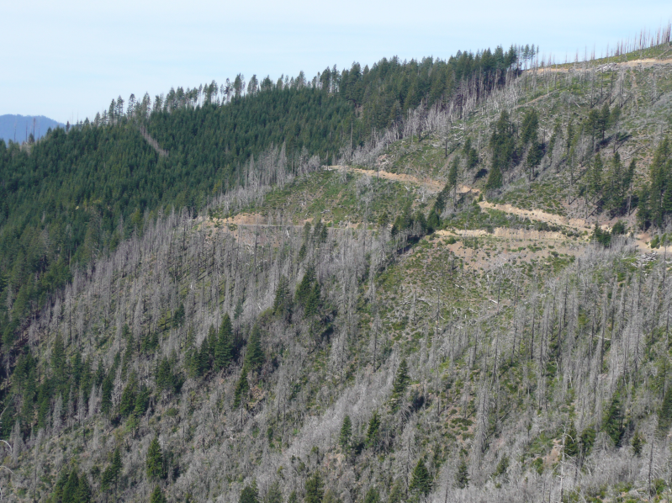
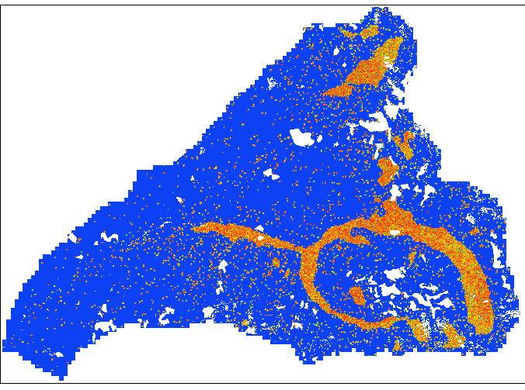

HJ Andrews ~ 1500 AD
http://iLand.boku.ac.at
1500
tree height
90m
0m
tree species
Pseudotsuga menziesii
Tsuga heterophylla
Thuja plicata
Abies amabilis
deciduous species

Slide 12
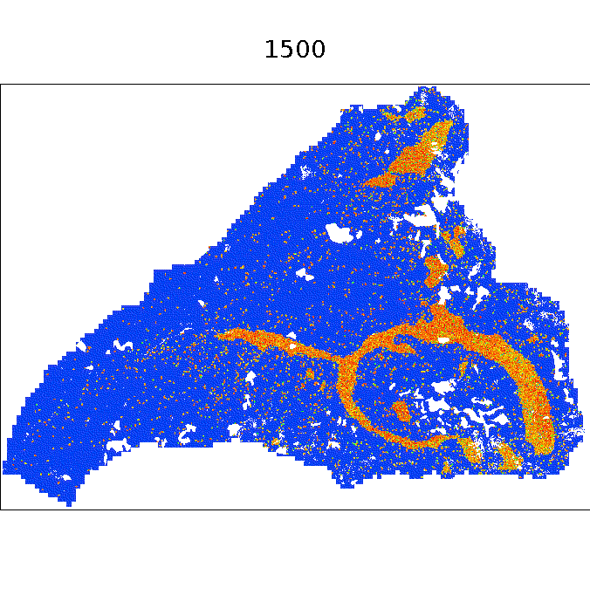
500 years of landscape dynamics…
http://iLand.boku.ac.at
tree height
90m
0m
tree species
Pseudotsuga menziesii
Tsuga heterophylla
Thuja plicata
Abies amabilis
deciduous species
simulation: annual timestep, individual tree resolution | animation: 10-year timestep, 10m grid resolution

Slide 13
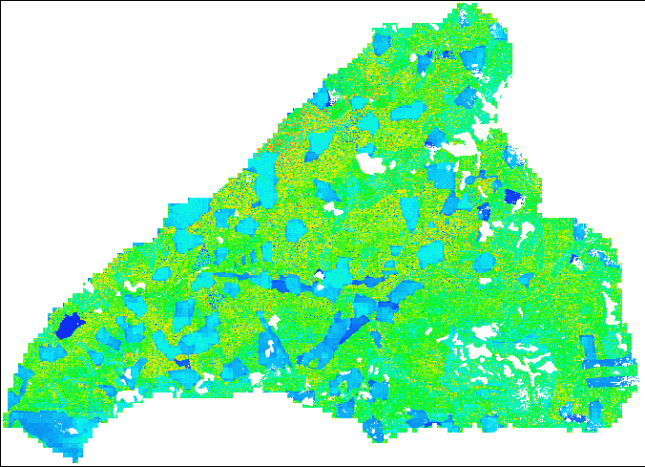
500 years of landscape dynamics…
http://iLand.boku.ac.at
2000
tree height
90m
0m
tree species
Pseudotsuga menziesii
Tsuga heterophylla
Thuja plicata
Abies amabilis
deciduous species
simulation: annual timestep, individual tree resolution | animation: 10-year timestep, 10m grid resolution

Slide 14
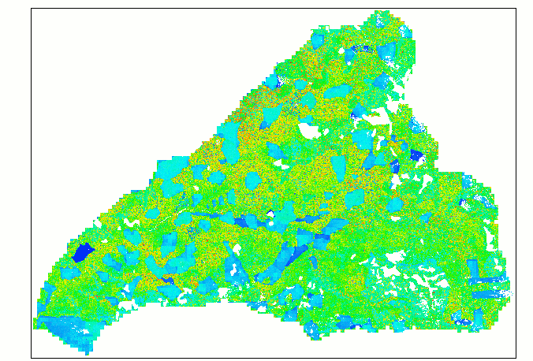
…at individual-tree resolution
http://iLand.boku.ac.at
tree height
90m
0m
tree species
Pseudotsuga menziesii
Tsuga heterophylla
Thuja plicata
Abies amabilis
deciduous species

Slide 15
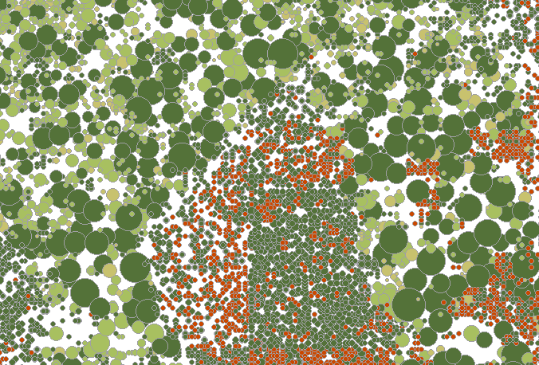
…at individual-tree resolution
http://iLand.boku.ac.at
tree height
90m
0m
tree species
Pseudotsuga menziesii
Tsuga heterophylla
Thuja plicata
Abies amabilis
deciduous species

Slide 16
C dynamics at the HJA
landscape
scale fire
19th century
fire episode
clear-cut
harvesting
landscape level evaluation
aboveground C

Slide 17
Conclusions
Lidar Useful for mapping biomass and carbon
Need ground plots to build model
LiDAR as way to evaluate ecosystem dynamics models
Seidl, Spies, Rammer, Steel, Pabst and Olsen. 2012. Multi-scale drivers of spatial
Variation in old-growth forest carbon density disentangled with Lidar and an individual
Based landscape model. Ecosystems.

Slide 18
Potential drivers of C variability
Climate data
daily time series since 1973
spatially interpolated to 100m grid
variables: temperature, precipitation, radiation, vpd
Soil data
326 soil profiles
imputed to soil mapping units
variables: soil depth, physical properties, N availability
Vegetation data
long-term research plots
gradient nearest neighbor imputation of FIA data
variables: basal area, QMD, number of big trees, etc.
sources (selection): Dyrness (2001), Dyrness et al. (2005), Daly and McKee (2009), Daly and Smith (2005), Ohmann et al. (2011), Harmon and Munger (2005)

Slide 19
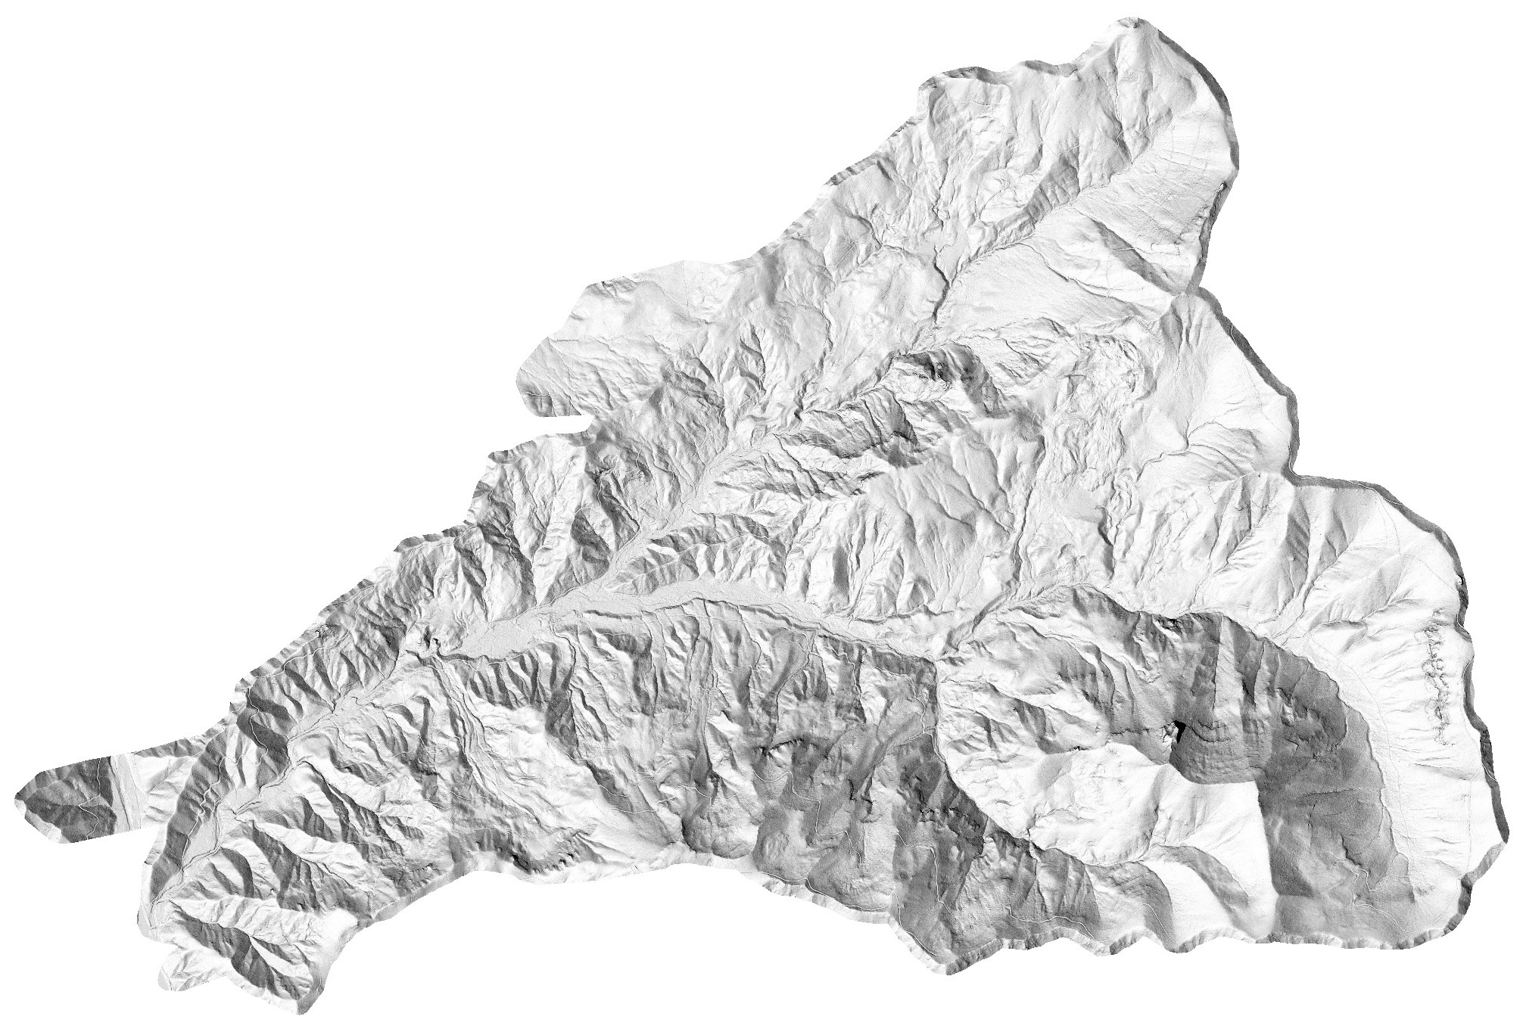
HJA Lidar (Aug 2008) Bare Earth Model

Slide 20
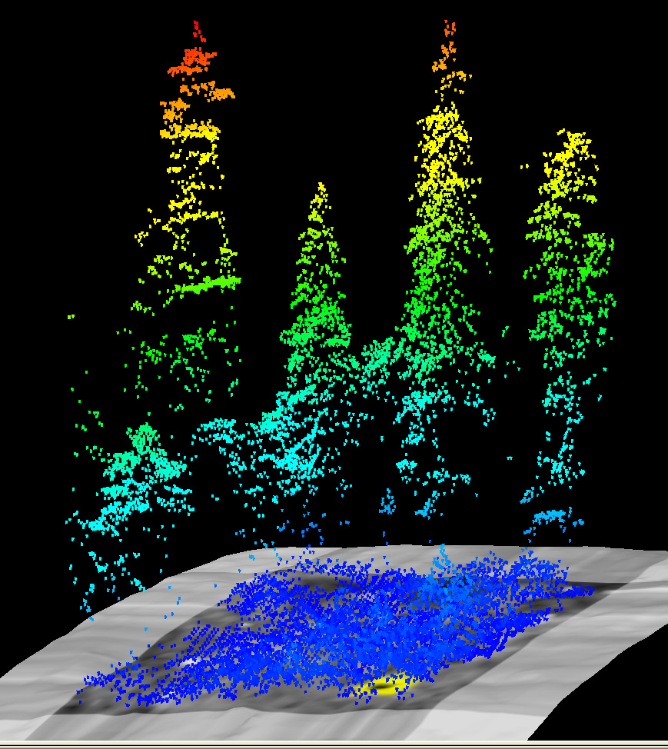
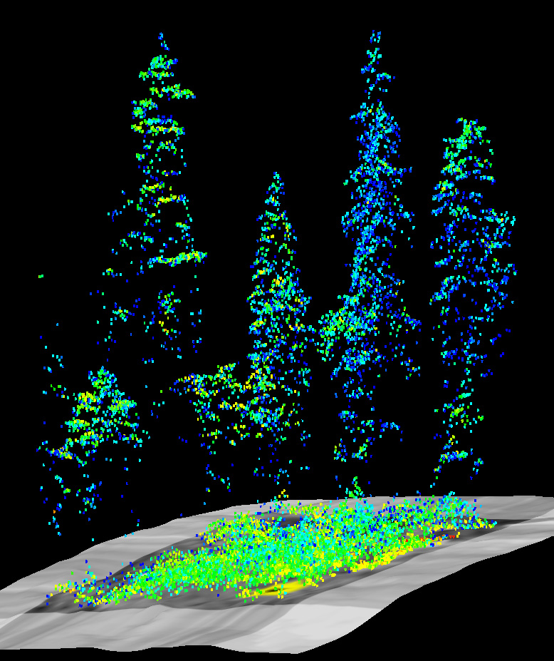
Large Gap Tree Height Near IR Intensity (blue is low)
Colors represent different heights above ground

Slide 21
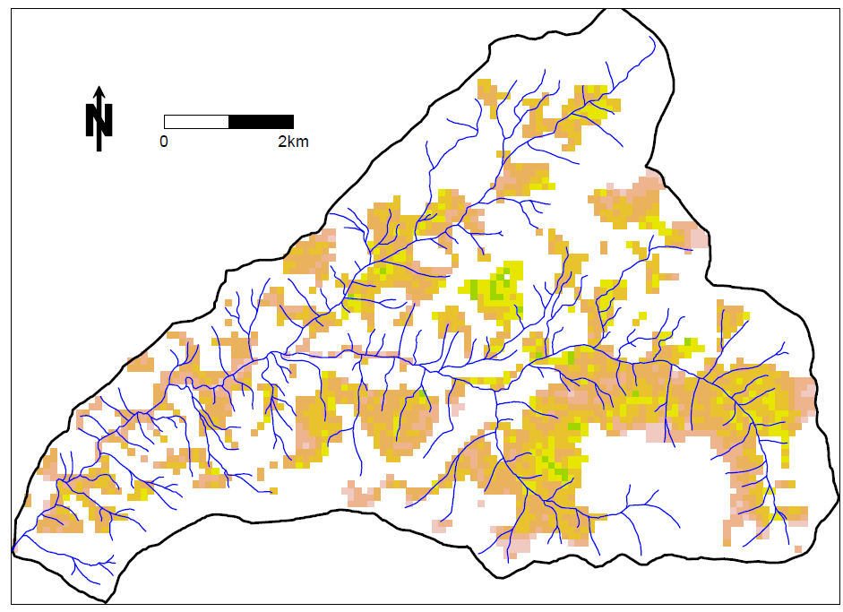
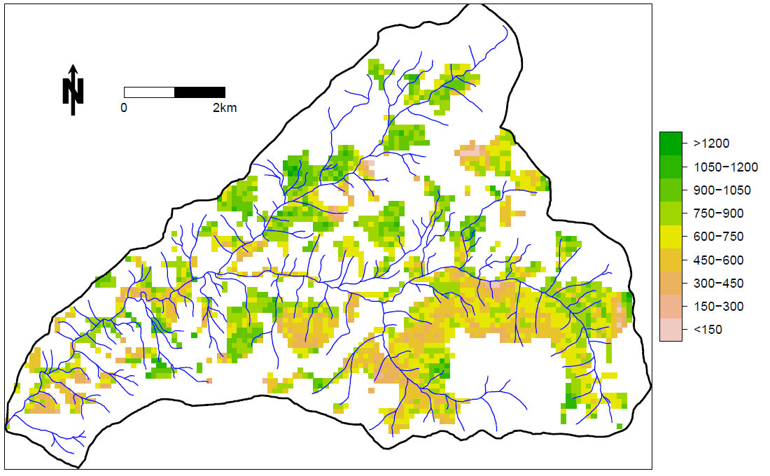
aboveground vs. total C density
aboveground live C
LIDAR
total ecosystem C
iLand
Mg C ha⁻¹
mean:
SD:
95th percentile:
435.1 Mg C ha⁻¹
149.2 Mg C ha⁻¹
667.3 Mg C ha⁻¹
mean:
SD:
95th percentile:
724.5.Mg C ha⁻¹
189.8 Mg C ha⁻¹
999.4 Mg C ha⁻¹

